Slide 1



UNIT 4
LESSON 14
Q for a question
Part 1

Slide 2
BILL GATES
JEFF BEZOS
American computer programmer and entrepreneur who cofounded Microsoft Corporation, the world’s largest personal-computer software company.
Source: britannica.com
American entrepreneur who played a key role in the growth of e-commerce as the founder and chief executive officer of Amazon.com, Inc., an online merchant of books and later of a wide variety of products. Under his guidance, Amazon became the largest retailer on the World Wide Web and the model for Internet sales.
Source: britannica.com
South African-born American entrepreneur who cofounded the electronic-payment firm PayPal and formed SpaceX, maker of launch vehicles and spacecraft. He was also one of the first significant investors in, as well as chief executive officer of, the electric car manufacturer Tesla.
Source: britannica.com
American computer programmer who was cofounder and CEO of Facebook, a social networking Web site.
Source: britannica.com
MARK ZUCKERBERG
ELON MUSK
Who are they?
What do you know about them?

Slide 3
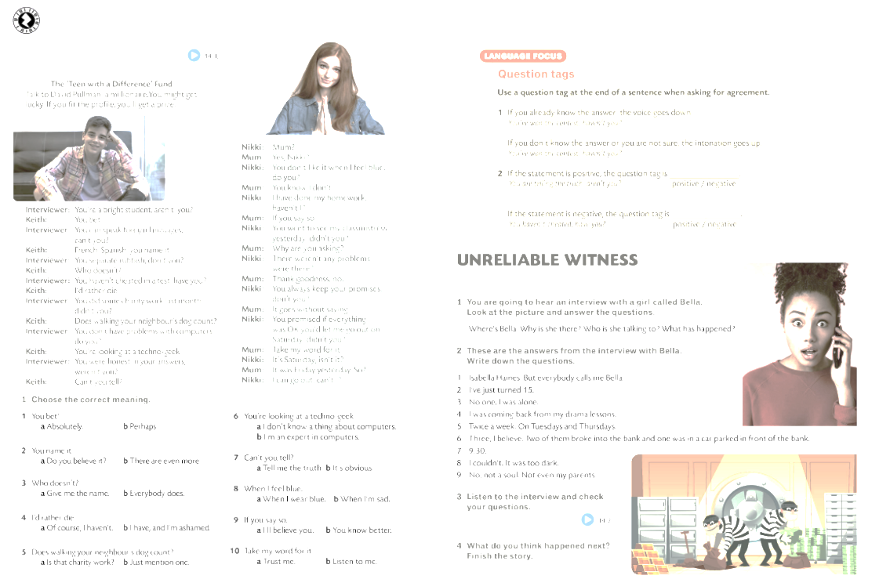


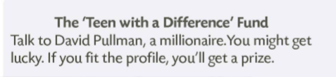






How to become a millionaire/billionaire? What should millionaires/billionaires do since they’re so rich? Help the poor, charity work, etc.?

Slide 4
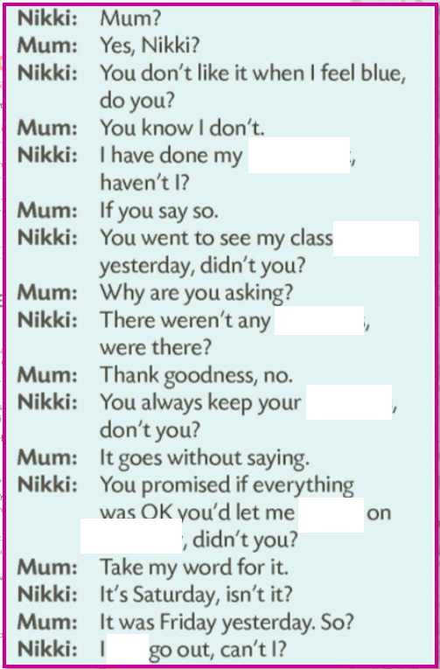

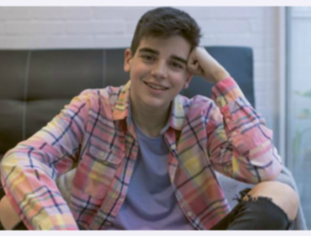
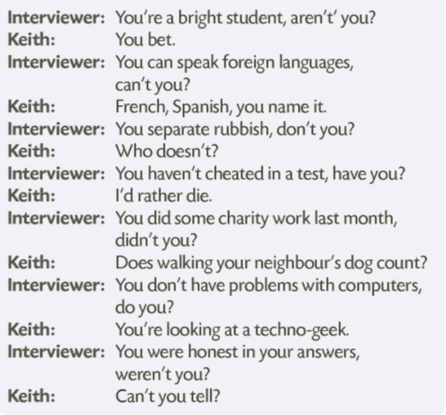
Do you think that Keith is going to get the prize? Why?
homework
mistress
problems
promises
go out
Saturday
can

Slide 5
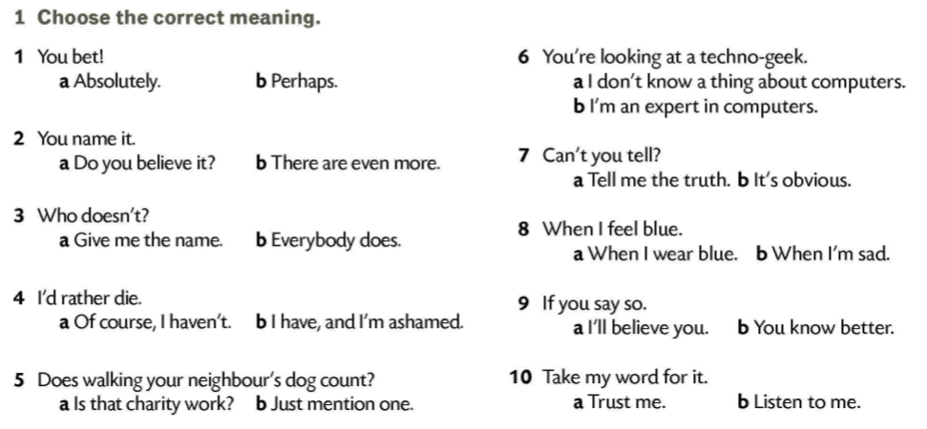

Slide 6
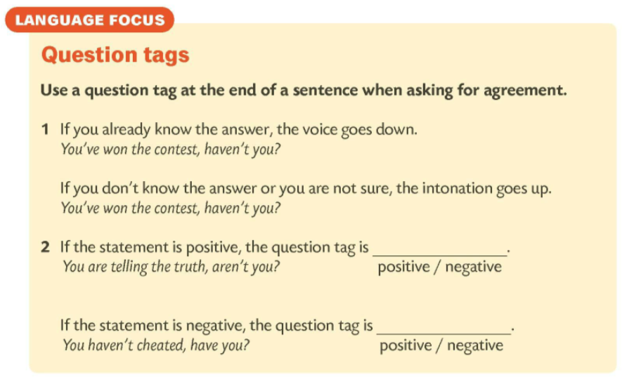
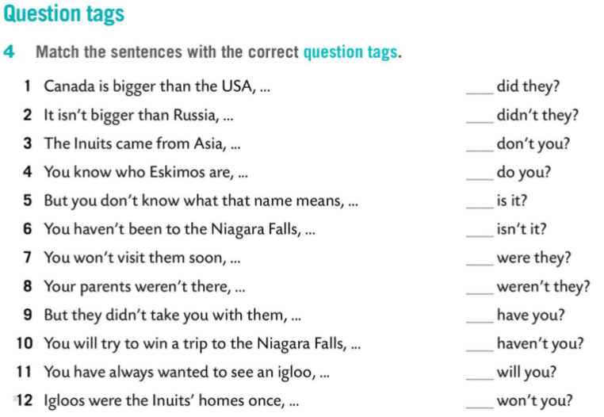
negative
9
positive
3
4
5
2
1
8
12
6
11
7
10

Slide 7
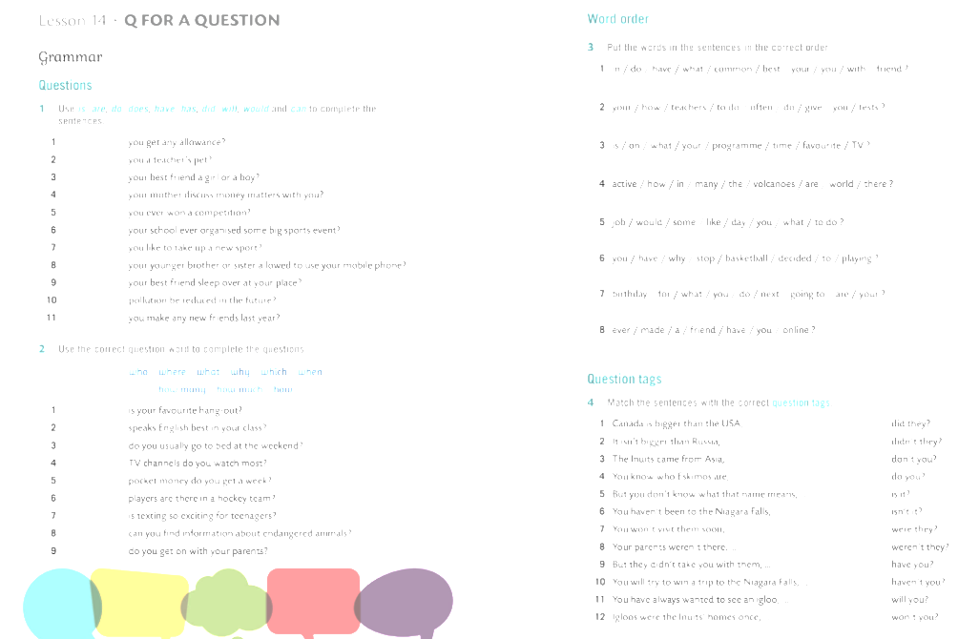
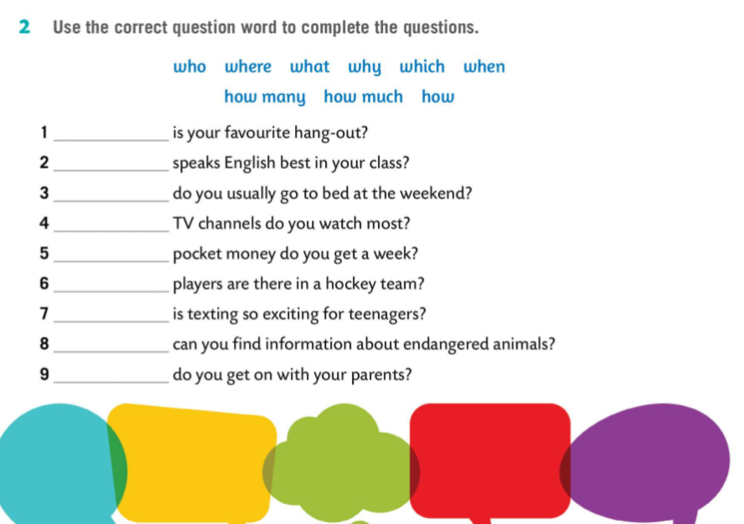
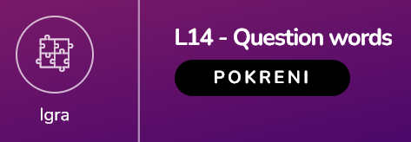


What
Who
When
Which
How much
How many
Why
Where
How

Slide 8
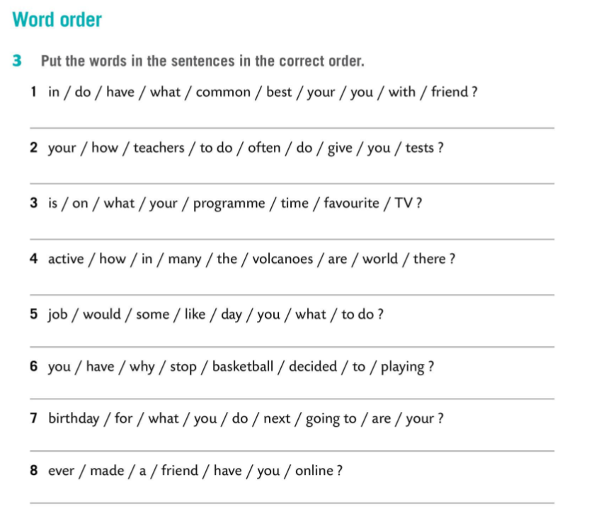
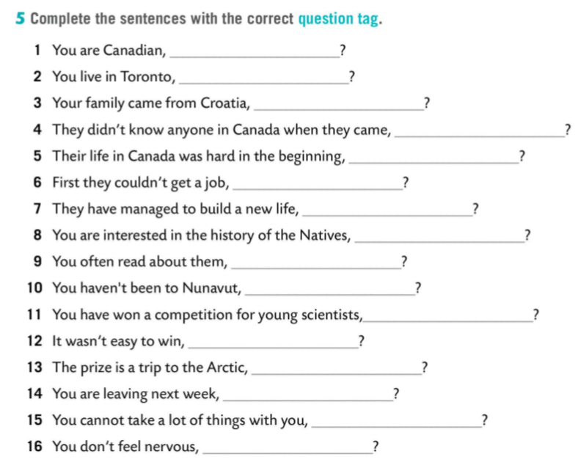
What do you have in common with your best friend?
How often do your teachers give you tests to do?
aren’t you
don’t you
What time is your favourite programme on TV?
didn’t they
did they
How many active volcanoes are there in the world?
wasn’t it
could they
What job would you like to do some day?
haven’t they
aren’t you
Why have you decided to stop playing basketball?
don’t you
have you
What are you going to do for your next birthday?
haven’t you
was it
Have you ever made an online friend?
isn’t it
aren’t you
can you
do you

